Slide 1

Restaurant Management System

Slide 2

INTRODUCTION

Slide 3
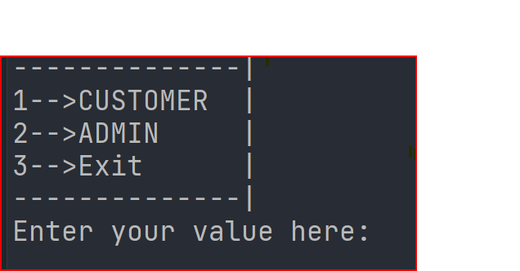
The Restaurant Management system comprises of 3 parts: Customer, Admin, Exit
In the customer section, customer is shown a menu of the restaurant, from which customer can select the items. At the end of the selection, customer is given the bill with all the items listed which is taken by the customer.
The admin section required a password to enter. The admin has various options available, which will be shown below. The admin can perform several tasks.
All the above functionality is performed by a loop. This loop is exited when the exit value is pressed.

Slide 4
METHODS & RESULTS

Slide 5

CUSTOMER SECTION

Slide 6
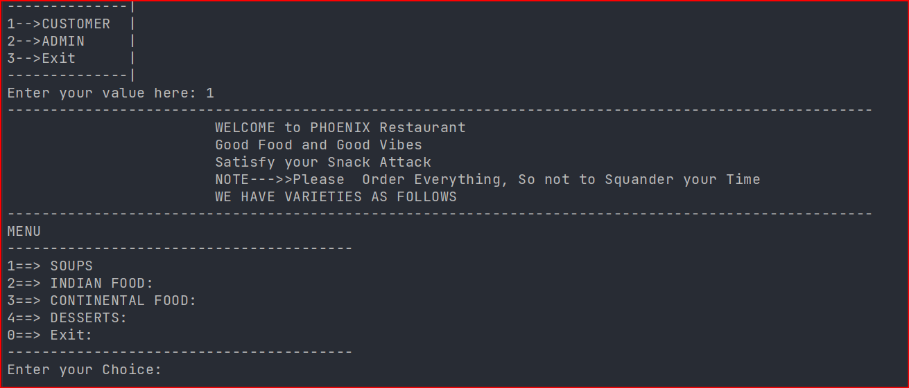
When customer presses 1 then the following screen will be appeared.

Slide 7
Here, the customer get the menu of the restaurant which includes soups, Indian foods, continental foods, and Desserts. The customer can select any of the above options by pressing the value assigned to the variable

Slide 8
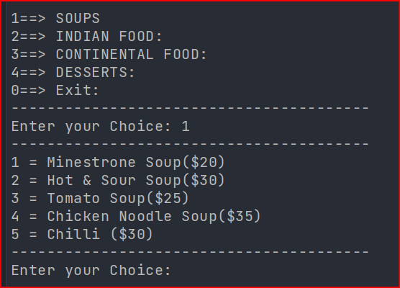
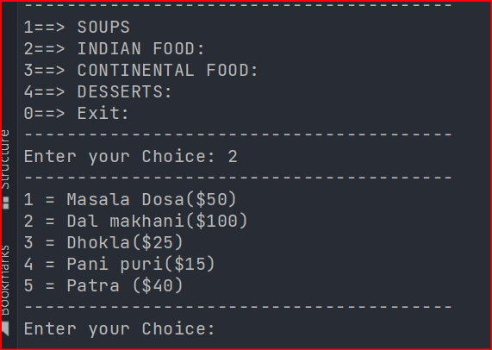
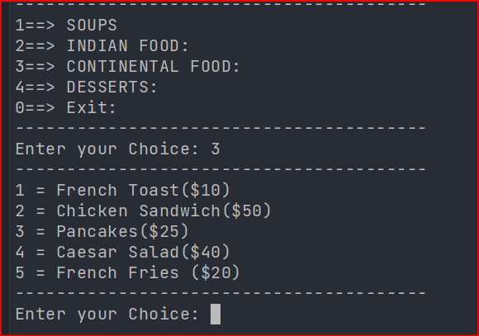
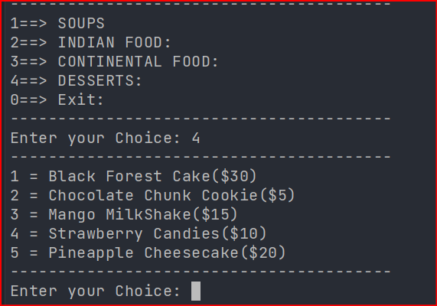

Slide 9
These are 4 food menu items given to the customer. Customer can select any food item from the menu as many times as want.

Slide 10
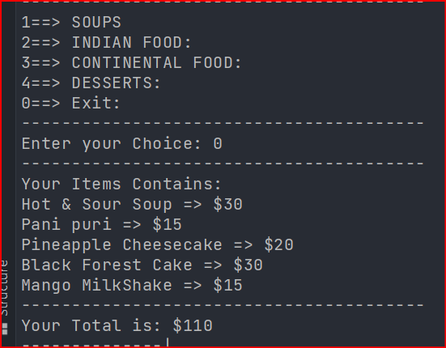
After selecting the items, the customer will be given bill at the end

Slide 11
ADMIN SECTION

Slide 12
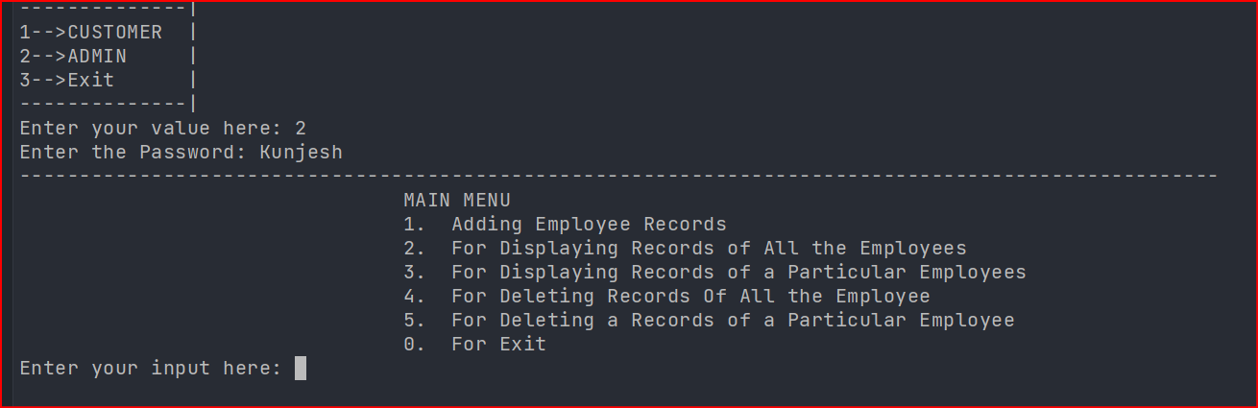
The admin section is given the following functionality. To access the admin section the user need a password. Here, I have used my name “Kunjesh” as a password.

Slide 13
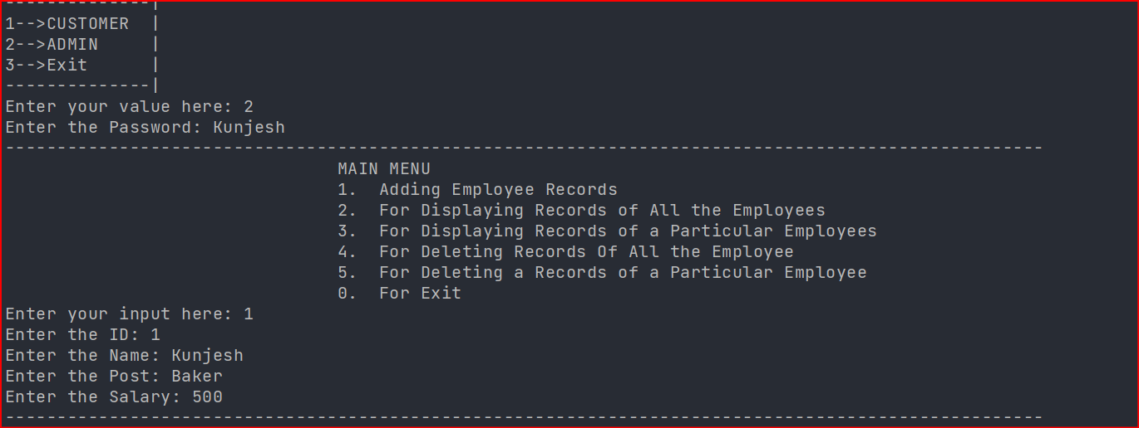
Adding an Employee Record

Slide 14
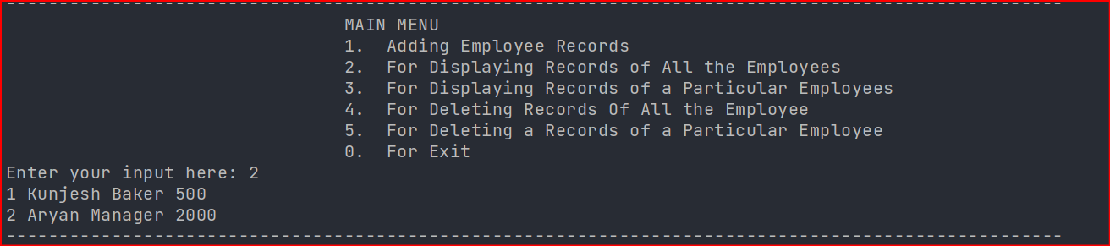
For Displaying All Employee

Slide 15
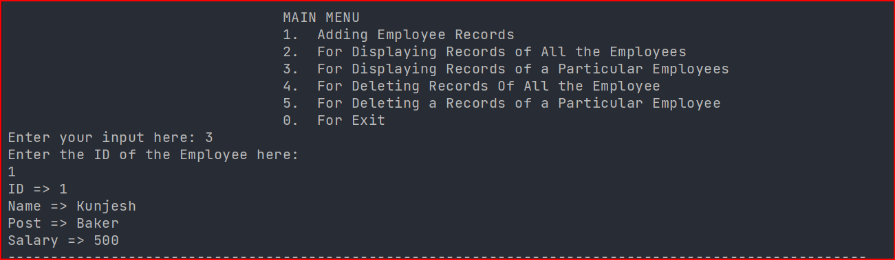
For Displaying the Record by ID

Slide 16
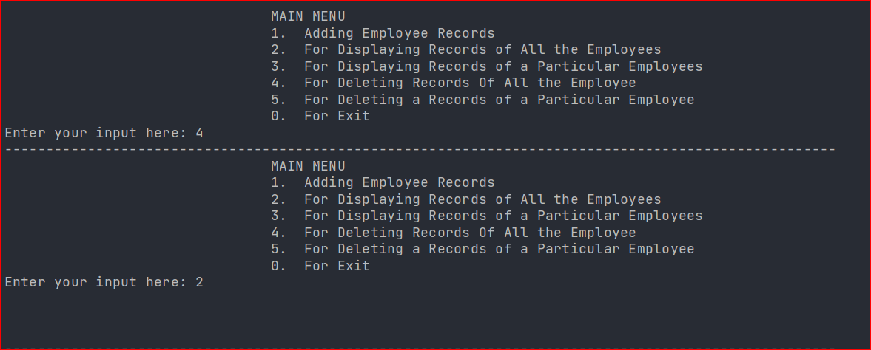
For Deleting all Employee Details
The value is replaced by NULL

Slide 17
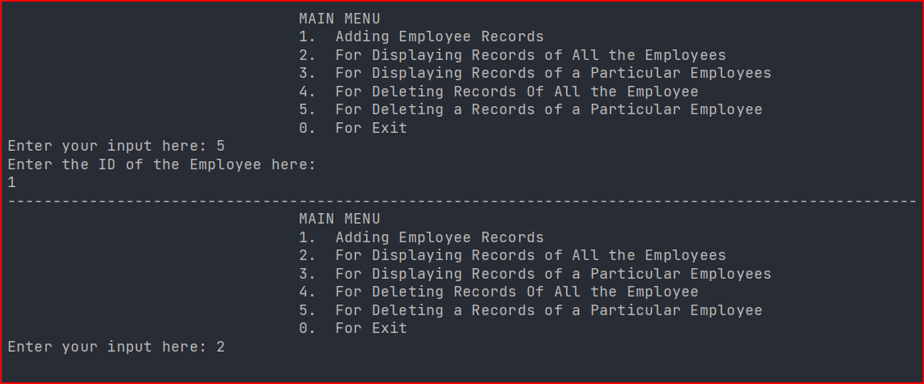
For Deleting Record by ID

Slide 18
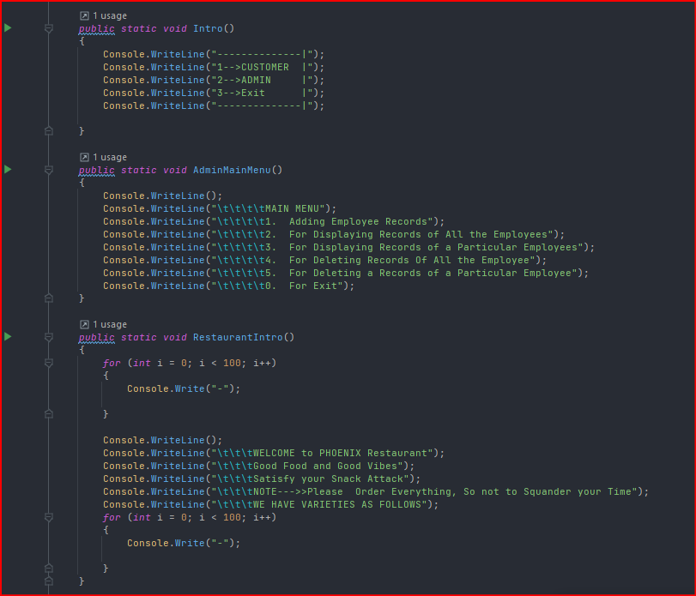
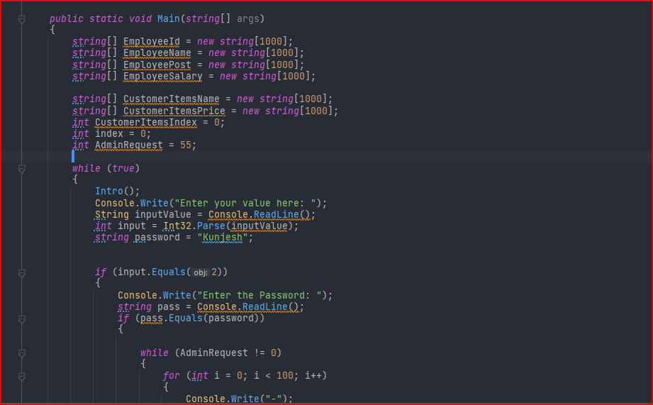


Connection of main method with other methods
Connection is explained in video

Slide 19
DISCUSSION

Slide 20
In this file everything is working, but there is a scope of improvement 1. The data of the employee are stored temporarily. It means that when the program is over, it will destroy the value of the employee. This is not good in real life. In this case, we can use database like MySQL, MongoDB to make connection with the code so that the data is stored permanently in the database.

Slide 21
2. In this code, customer can only give order once, there is no option to order again or resume the previous order. This is a drawback. 3. Customer cannot order more than 1 quantity. TO add more customer has to again order it. It can be improved. 4. Admin has limited options. Option for modifying data of employee, editing the menu is not available. 5. It does not has catch graphics or attractive interface.

Slide 22
CONCLUSION

Slide 23
1. I will try to make connection with MySQL and tries to store data in the database. 2. I will create a logic in such a way that the loop stops when customer press a button and again resume it when customer will ready to order again. 3. I will make a variable and ask the user to enter quantity and store the quantity in the variable.

Slide 24
4. I will add more option for the admin. 5. I will try to add more catchy graphics.

Slide 25
THANK YOU

